Slide 1

Physical Inventory Training
Notes:
Physical Inventory Training

Slide 2
Physical Inventory Training
Updated 10/12/2016
Notes:
Welcome to Kelly Paper Online Training.
My name is David Mount
The title of this presentation is Physical Inventory Training

Slide 3
Steps to Physical Inventory
Preparation
Counting
Entering Counts
Researching Variance
Post Physical Inventory Counts
Notes:
Steps to Physical Inventory
Preparation
Counting
Entering Counts
Researching Variance
Post Physical Inventory Counts

Slide 4
Preparation-Two Weeks Before Inventory
Submit your petty cash voucher to accounting.
You will need money for supplies, lunch and possibly dinner.
This will be enough time to get a check back before inventory.
Notes:
Starting two weeks before inventory:
Submit your petty cash voucher to accounting.
You will need money for supplies, lunch and possibly dinner.
This will be enough time to get a check back before inventory

Slide 5
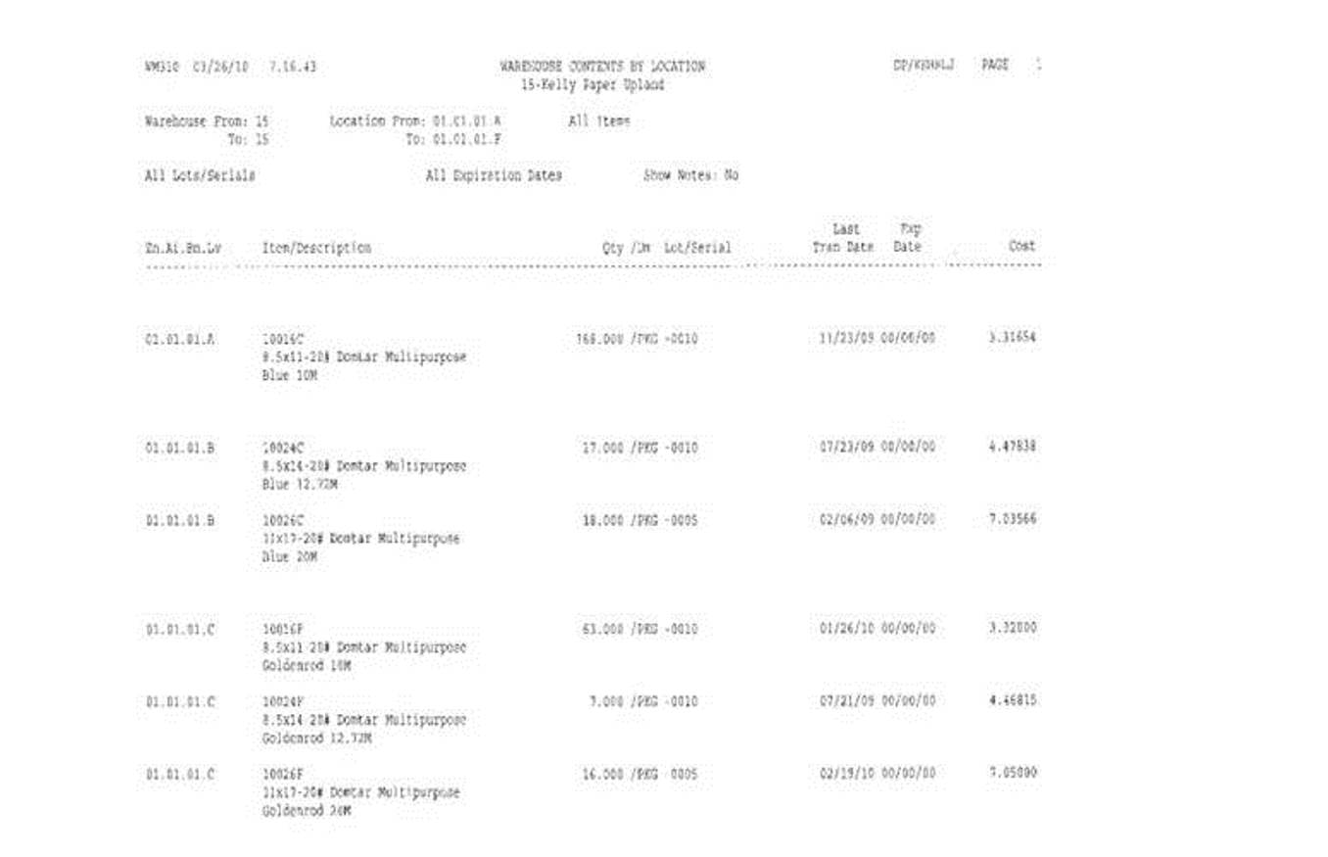
Preparation-Two Weeks Before Inventory
Contents by location report
Notes:
Run the Contents by location report
This report is a critical part of inventory preparation.
The report is a mirror image of your count sheets.
Therefore using this as a preparation tool is the single most important factor in determining a successful and timely inventory result.

Slide 6
Preparation-Two Weeks Before Inventory
Verify all your bin locations are correct.
  Walk your floor checking each bin against your contents by location report.
  If your report does not match the actual product in the bin you must do a bin move in the system to the correct bin and verify the override locations.
Notes:
Verify all your bin locations are correct.
Print contents by location report.
Walk your floor checking each bin against your contents by location report.
If your report does not match the actual product in the bin you must do a bin move in the system to the correct bin and verify the override locations.

Slide 7
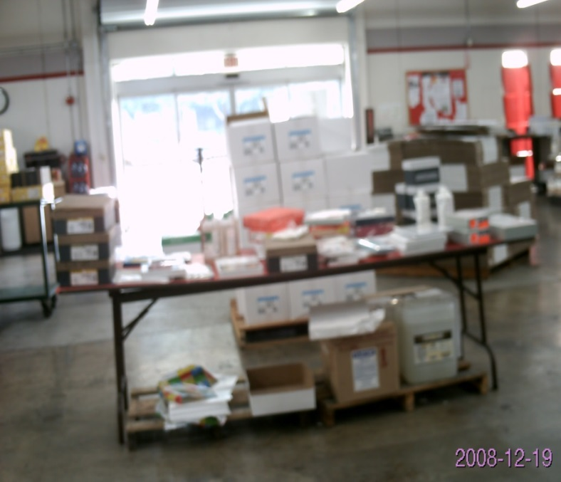
Preparation-Two Weeks Before Inventory
Check the bargain area.
Separate product labeled 44000Z from product to count.
Make sure a bin location is listed for product to be counted.
Notes:
Check the bargain area.
Separate product labeled 44000Z from product which will be counted.
Make sure a bin location is listed for product to be counted.

Slide 8
Preparation-Two Weeks Before Inventory
Time permitting a second person should then walk the floor with a new contents report to double check for accuracy.
The result of physical inventory is 90% preparation and 10% of what you do on inventory day.
Notes:
When ever possible a second person should then walk the floor with a new contents by location report to double check for accuracy.
Remember:
The result of your physical inventory count is 90% preparation and 10% of what you do on inventory day.
So the better you prepare the better your result will be.

Slide 9
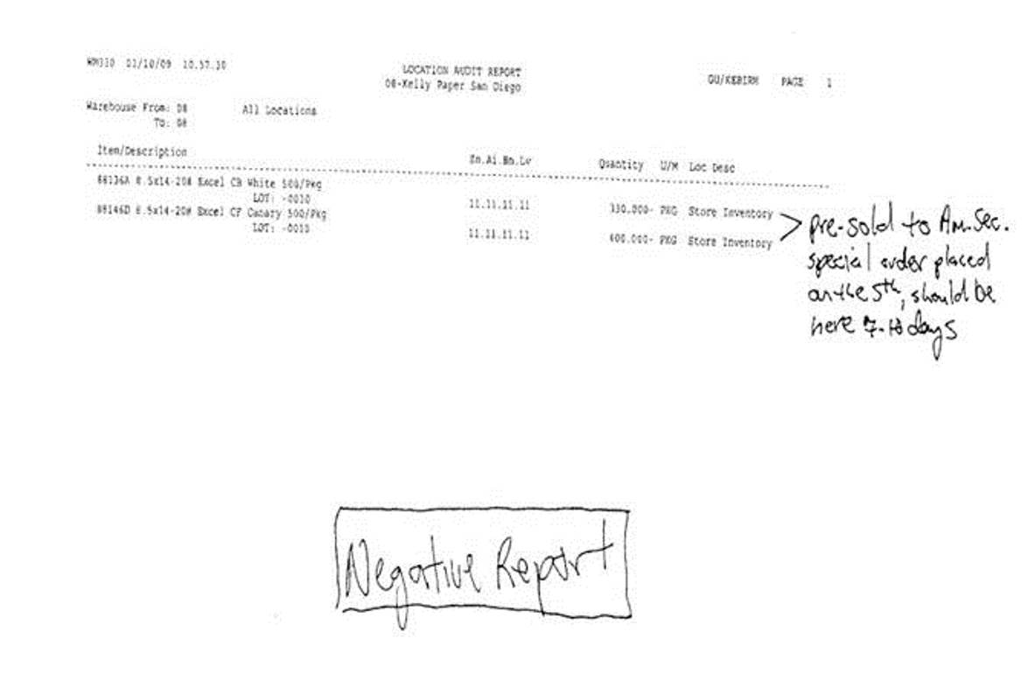
Preparation-One Week Before Inventory
Print the Location Audit Report.
  Manage your negatives by bin.
  You cannot have any negatives going in to inventory.
Notes:
One Week Before Inventory
Print the Location Audit Report.
Manage your negatives by bin.
You cannot have negatives going in to inventory.

Slide 10
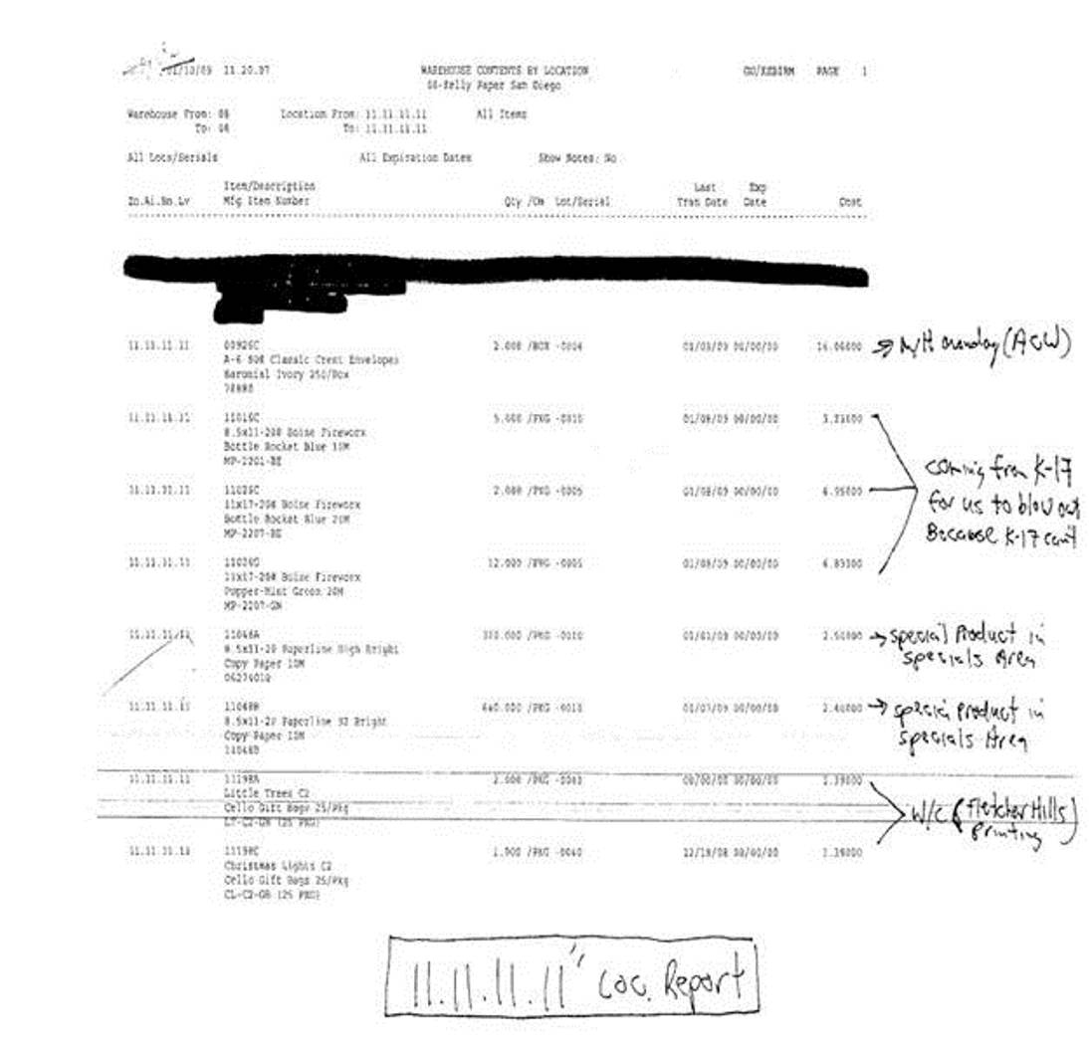
Preparation-One Week Before Inventory
Print Contents by Location Report for your 1’s.
  Manage your 1’s.
Notes:
Print and manage the Contents by Location Report for your 1’s.

Slide 11
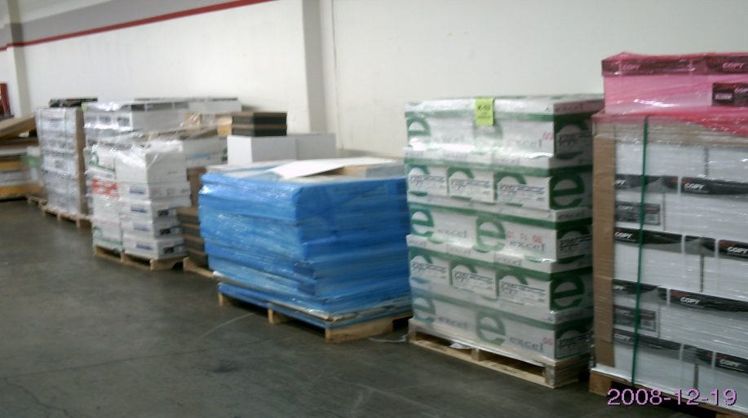
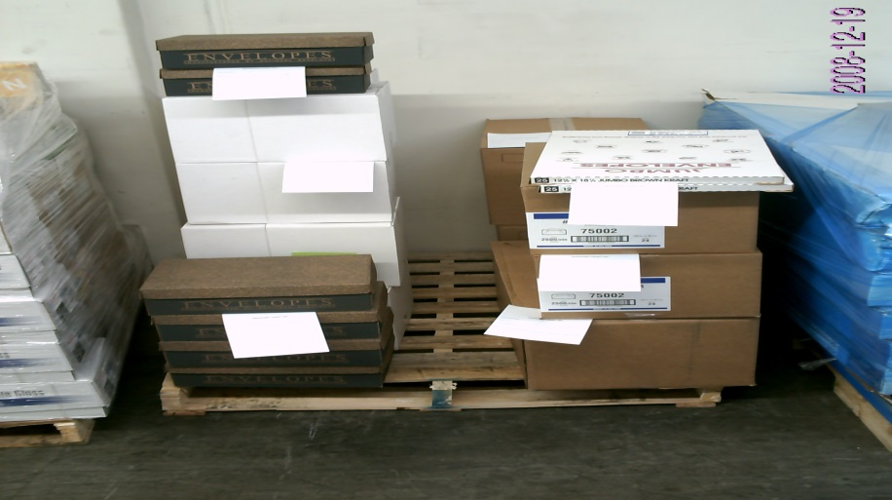
Preparation-One Week Before Inventory
All excess needs to be separated into 2 areas.
First area is non-stock.
Second area is stocking items.
All non-stock should be in your 1’s and counted on a count sheet.
All stocking items will be counted on an inventory count tag and with product in the aisle.
Stocking Items
Non-stock
Notes:
All excess needs to be separated in to 2 areas.
The first area is non-stock.
The second area is stocking items.
All non-stock should be in your 1’s and counted on a count sheet.
All stocking items will be counted on an inventory count tag and with product in the aisle.

Slide 12
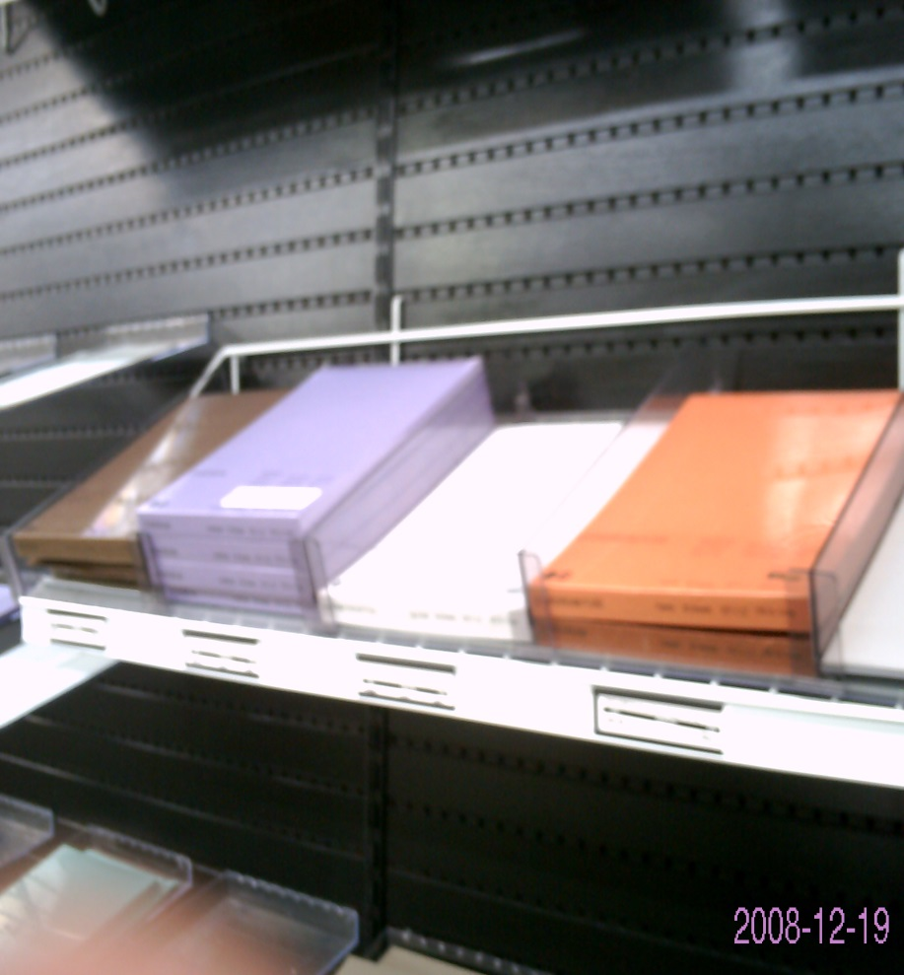
Preparation-One Week Before Inventory
Employees should be looking product in the wrong bin.
Tape up open packages.
Filling sample bins.
Adjusting any samples out of inventory.
Writing off damaged stock and usage items.
Make sure you have a back up toner cartridge for your printer.
Notes:
Employees should be looking for product in the wrong bin.
Tape up open packages. Fill sample bins.
Adjusting any samples out of inventory.
Writing off damaged stock and usage items.
Make sure you have a back up toner cartridge for your printer.

Slide 13
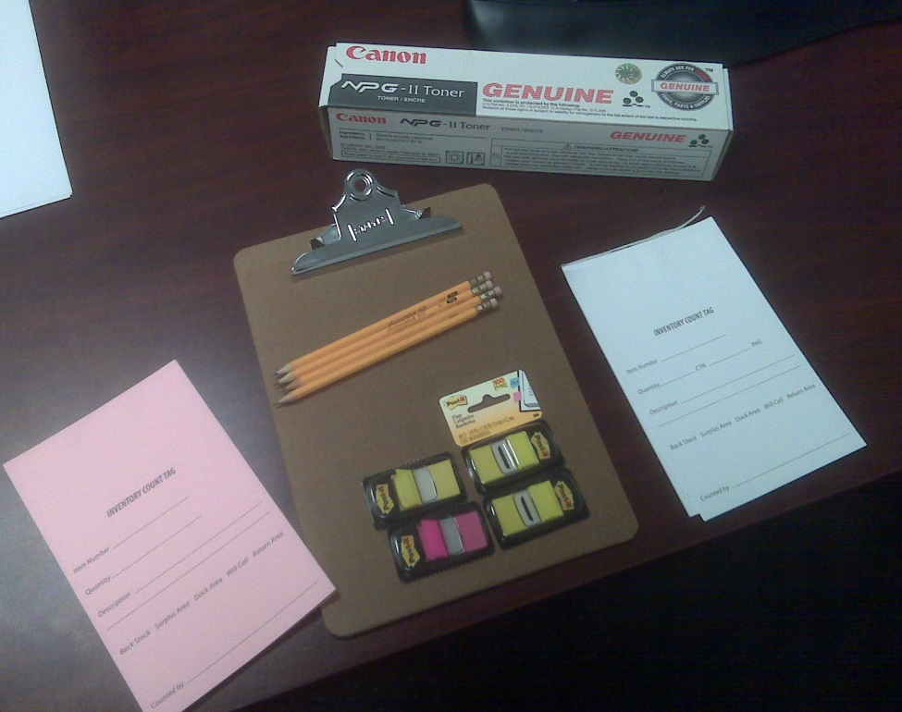
Preparation-Day Before Inventory
Make sure all supplies are ready:
  Pencils
  Toner
  Count tags
  clipboards
  Colored Post It tags
  etc.
Notes:
Preparation-Day Before Inventory
Make sure all supplies are ready:
Pencils
Toner
inventory count tags
clipboards
Colored Post It tags

Slide 14
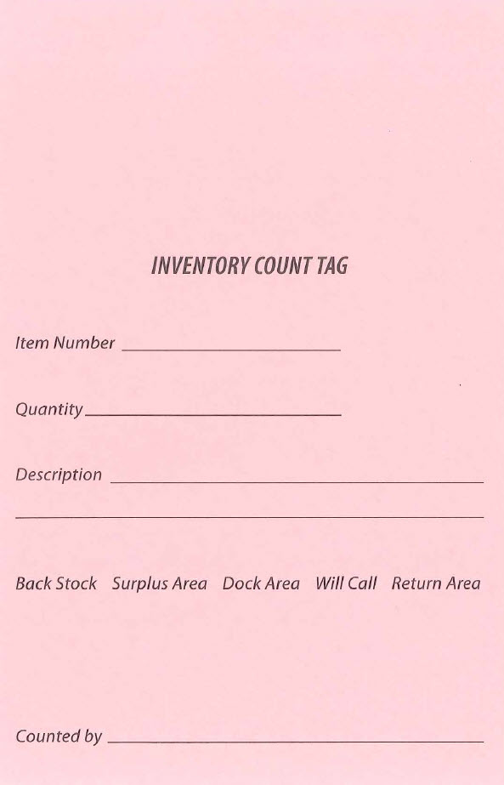
Preparation-Day Before Inventory
Inventory Count Tag
  This is a 2 part form
    The top is Pink
    The bottom is Goldenrod
  This tag is used to count items in back stock, surplus, dock area, will call and return area
Notes:
Inventory Count Tag
This is a 2 part form
The top is Pink
The bottom is Goldenrod
Because A+ allows only one bin location per item for store inventory management, the Inventory Count Tag is used to record counts for items from back stock, surplus, the dock area, will call and return areas into the primary A+ bin location for each item.

Slide 15
Preparation-Day Before Inventory
All orders are to be placed in the usual manner.
The Distribution Centers will invoice all orders in status 3 (ship confirmed) with Monday’s date.
You must make sure all transfer orders are ship confirmed before you go home.
You must be up to date on all mill receiving for your location.
Notes:
All orders are to be placed in the usual manner.
The Distribution Centers will invoice all orders in status 3 (ship confirmed) with Monday’s date.
You must make sure all transfer orders are ship confirmed before you go home.
You must be up to date on all mill receiving for your location.

Slide 16
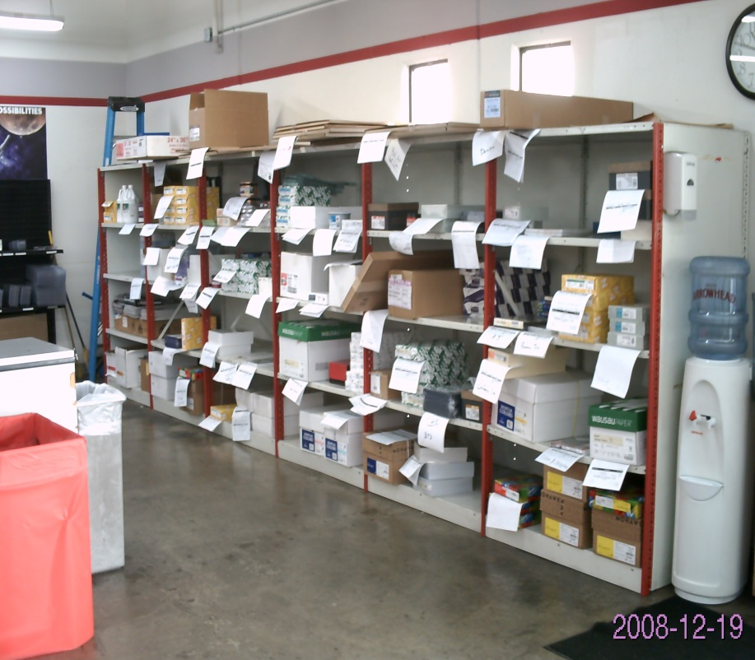
Preparation-Day Before Inventory
Put away all old must have and will call orders after closing.
Anytime throughout the day begin pre-counting graphics, retail and packaging with a contents by location report.
You may also run your count sheets and use the sections for areas that you will be pre-counting.
Notes:
Put away all old must have and will call orders after closing.
Anytime throughout the day begin pre-counting graphics, retail and packaging with a contents by location report.
Alternatively, you may also run your count sheets and use the sections for areas that you will be precounting.
Pre-invetory count sheets must be canceled after the sheets are printed.

Slide 17
Preparation-Day Before Inventory
Pre-counting is a method of recording physical inventory counts for sections that are time consuming.
These counts are then transferred to count sheets for entry into A+ on the day of the physical count.
Pre-counting must be done using a pencil so that any changes to the count can be made easily.
Pre-counts may change due to an item being sold or a Must Have order coming in.
Notes:
Pre-counting is a method of recording physical inventory counts for sections that are time consuming.
These counts are then transferred to count sheets for entry into A+ on the day of the physical count.
Pre-counting must be done using a pencil so that any changes to the count can be made easily.
Pre-counts may change due to an item being sold or a Must Have order.

Slide 18
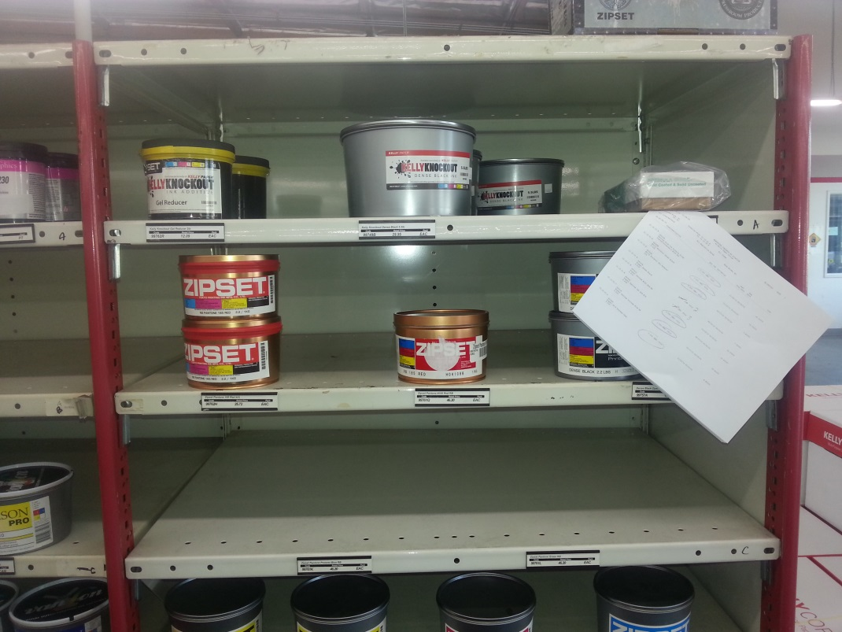
Preparation-Day Before Inventory
To pre-count using the Contents by Location Report do the following:
  Print Contents by Location Report for the bin range to pre-count.
  If inventory is correct circle the quantity listed.
  If not put a line through the quantity listed and record actual count.
Note: If an item comes in on the day of inventory that item must be added to the pre-count.
Notes:
To pre-count using the Contents by Location Report do the following:
Print Contents by Location Report for the bin range to pre-count.
If inventory is correct circle the quantity listed.
If not put a line through the quantity listed and record actual count.
Note: If an item comes in on the day of inventory that item must be added to the pre-count.

Slide 19
Preparation-Day Before Inventory
To Use Count Sheets to pre-count
  Count sheets do not show current inventory.
  Record the count for the items on your count sheets.
  Note: If an item comes in on the day of inventory that item will need to be added to the pre-count.
Notes:
To Use Count Sheets to pre-count do the following:
Unlike the contents by location report, Count sheets do not show current inventory.
Carefully record the count for all items on your count sheets.
Note: If an item comes in on the day of inventory that item will need to be updated on the pre-count.

Slide 20
Preparation-Day of Inventory
Do not make any inventory adjustments.
Do not create any dispute P.O.’s.
The physical counts will correct any shipment errors for this day.
Notes:
Preparation-Day of Inventory
Do not make any inventory adjustments.
Do not create any dispute P.O.’s.
Your physical count will correct any shipment errors for this day.

Slide 21
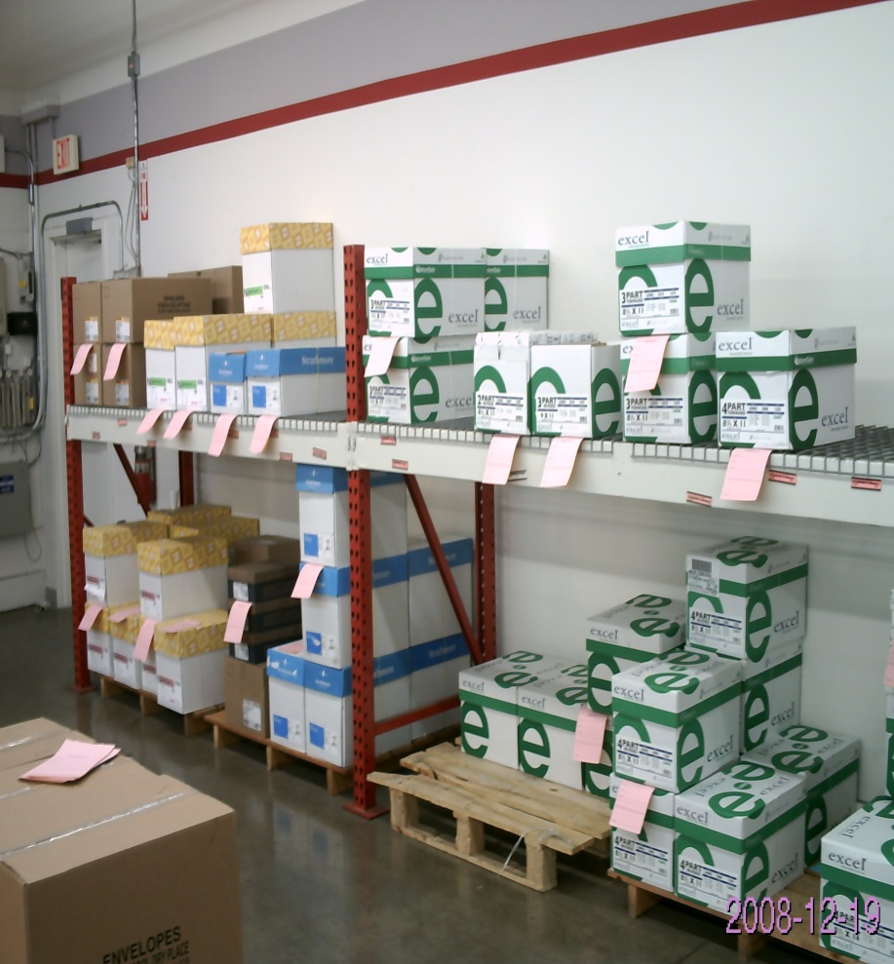
Preparation-Day of Inventory
Do not check in stock replenishment.
Put stock away on Saturday before you begin counting.
If there is an Inventory Count Tag, Count Sheet or Contents by Location Report attached to an item, update the quantity for all pre-counted items received the day of your physical count.
Notes:
Do not check in stock replenishment.
Put stock away on Saturday before you begin counting.
If there is an inventory count tag, Count Sheet or Contents by Location Report attached to an item, update the quantity on the inventory count tag, count sheet or contents report.

Slide 22
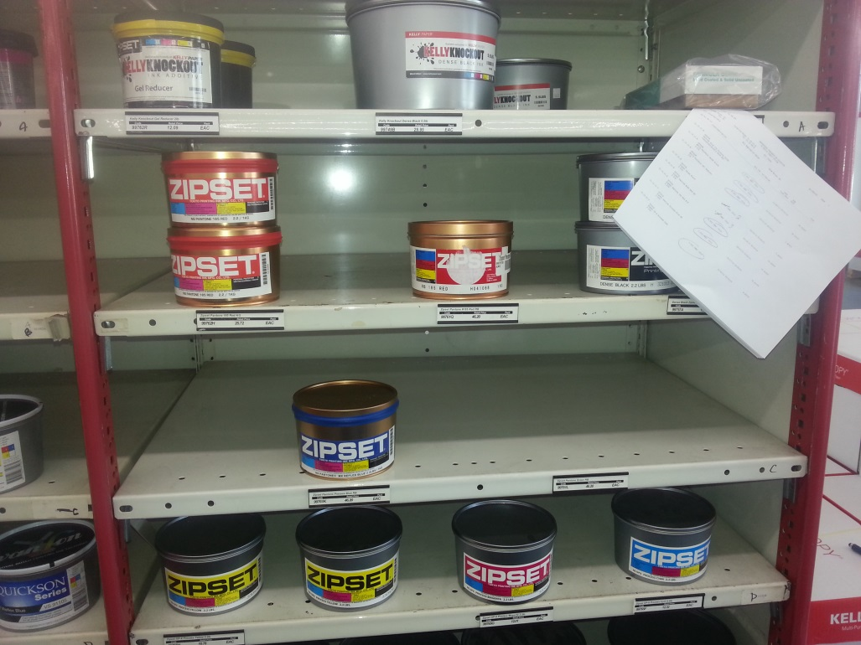
Preparation-Day of Inventory
When updating pre-counts on the Contents by Location report for items that where not on the report initially.
  Add the item to the report in the space on the report that it would have been in in relation to the other items on the initial report.
Notes:
When updating a pre-count on a Contents by Location report for items that where not on the report initially.
Add the item to the report in the space on the report where it would have been in relation to the other items on the initial report.

Slide 23
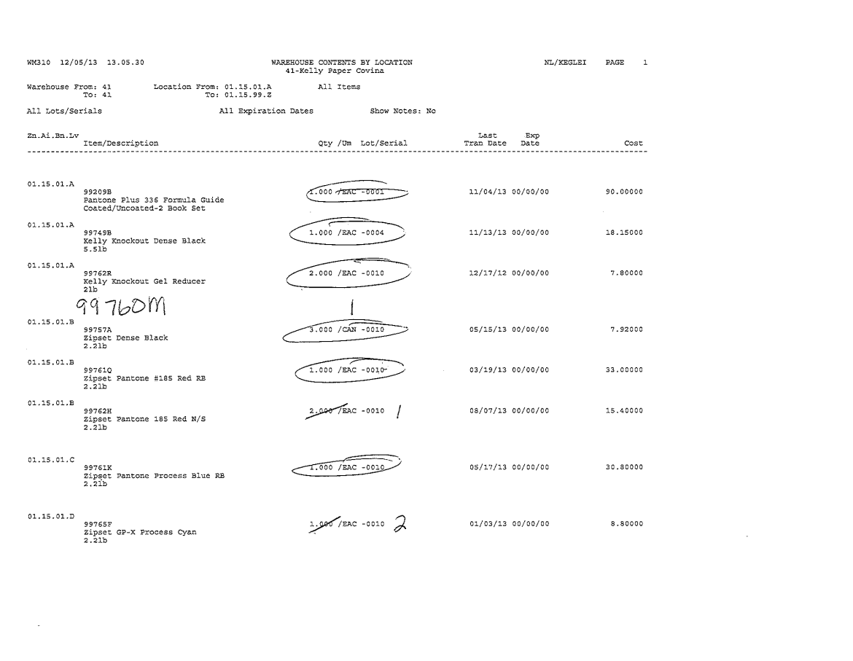
Notes:
Remember this report was used to pre-count the day before inventory and therefore items that were not in inventory where not on the initial report.

Slide 24
Preparation-Day of Inventory
Any two-day transfers must be counted by the receiving store. Make a copy of the put-away list or write up on an inventory count tag and attach to shelf count or count with your 1’s.
All P.O. receivers must be completed,
  This is only for product you have received or are going to count.
  P.O.’s you have not physically received will remain open.
Notes:
Any two-day transfers must be counted by the receiving store. Make a copy of the put-away list or write up on an inventory count tag and attach it to the shelf count or with your non-stock items.
All P.O. receivers must be completed,
This is only for product you have received or are going to count.
Open vendor P.O.’s that you have not physically received will remain open.

Slide 25
Preparation-Day of Inventory
All Company 1 and 99 open orders must be completed before 8:30 am.
  This means all orders must be invoiced or deleted.
  There can be no open orders in PS Printed or Ready Invoice status.
Notes:
All Company 1 and 99 open orders must be completed before 8:30 am.
This means all orders must be invoiced or deleted.
There can be no open orders in PS Printed or Ready Invoice status.

Slide 26
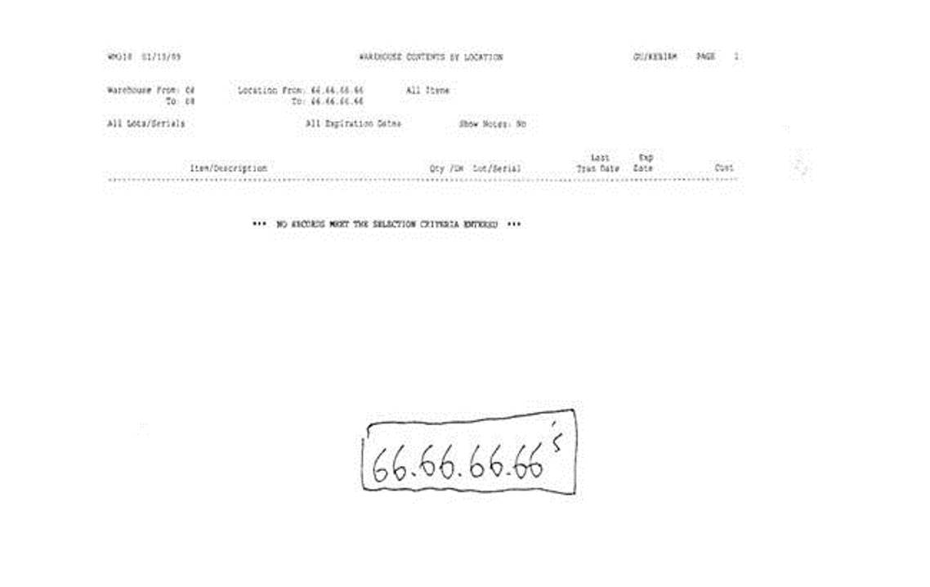
Preparation-Day of Inventory
Print contents by location reports for locations: 55.55.55.55, 66.66.66.66, 77.77.77.77, 88.88.88.88, and 99.99.99.99.
If you have inventory in any of these locations you must move it to your override location.
Notes:
Print contents by location reports for locations:
5’s, 6’s, 7’s, 8’s and 9’s
If you have inventory in any of these locations you must move it to the appropiate override location.

Slide 27
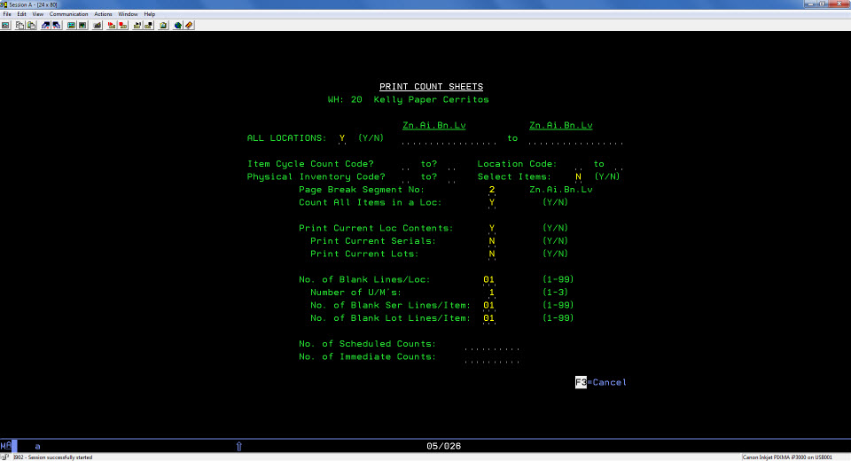
Preparation-Day of Inventory
Print your count sheets as soon as the previous steps are done.
Notes:
You are ready to print your count sheets only after all of the previous steps are done.
for instructions on printing count sheets see the EPAK topic Print Count Sheets

Slide 28
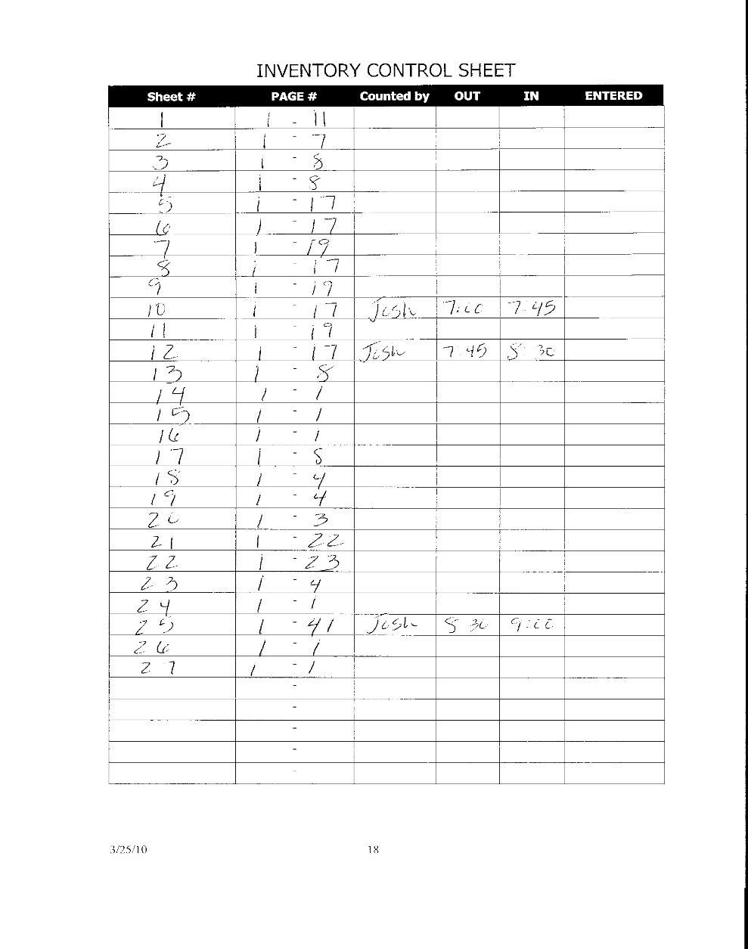
Preparation-Day of Inventory
Create your inventory control sheet once the count sheets have printed.
This form is a required part of the inventory process.
This sheet is important for the tracking your progress during physical inventory.
It also provides a system of checks and balances to ensure that inventory counts are not missed.
Notes:
Create your inventory control sheet once the count sheets have printed.
This form is a required part of the inventory process.
This sheet is important for the tracking your progress during physical inventory.
It also provides a system of checks and balances to ensure that inventory counts are not missed.

Slide 29
Counting Procedures
Do not enter any counts before 9:00 am.
Counting of inventory can be done individually or in teams.
All items are to be counted in the lowest unit of measure.
Be sure inventory is counted in proper quantities for all items.
  Count sheet will show correct unit of measure for items.
Notes:
Do not enter any counts before 9:00 am.
Counting of inventory can be done individually or in teams.
All items are to be counted in the lowest unit of measure.
Be sure inventory is counted in proper quantities for all items.
The Count sheets will show the correct unit of measure for items.

Slide 30
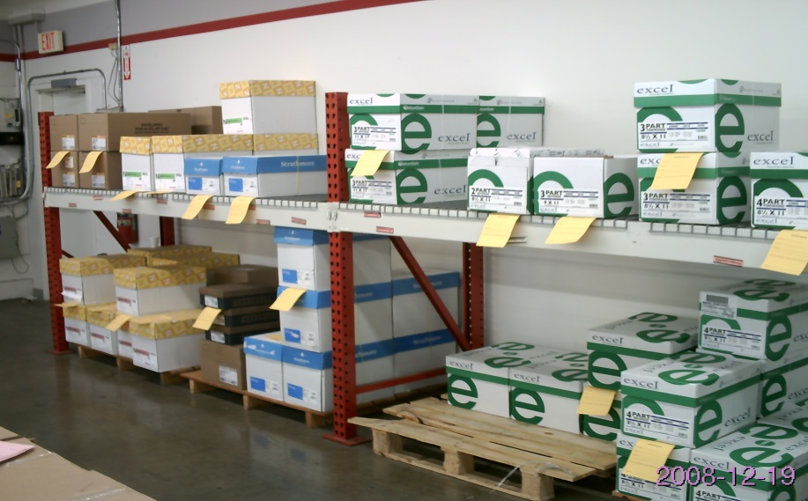
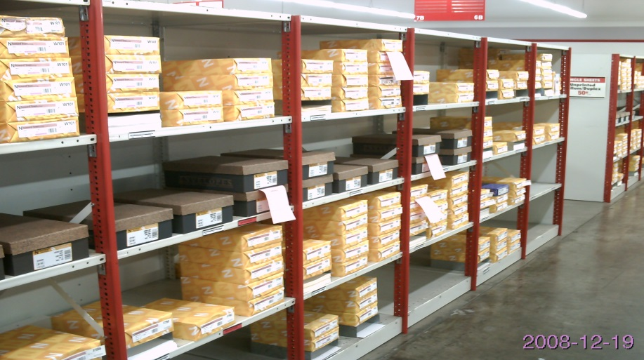
Counting Procedures
Record actual count from back stock, dock area, will call or surplus on two-part inventory count tags.
Place top copy (Pink) of inventory count tag in bin to be counted
Leave second copy (Goldenrod) with product you have counted.
Notes:
Record actual count from back stock, dock area, will call or surplus on two-part inventory count tags.
Place the top (Pink) copy of inventory count tag in bin to be counted
Leave the second (Goldenrod) copy with product you have counted.

Slide 31
Counting Procedures
Record actual count from bin and any inventory count tags or contents reports to your count and record on count sheet. Counts must be written in pencil.
Tag each location as they are counted with a colored Post It; it is not necessary to tag each sku item, but each bin.
Notes:
Record actual count from bin and any inventory count tags or contents reports to your count and record on count sheet.
Counts must be written in pencil.
Tag each location as they are counted with a colored Post It; it is not necessary to tag each sku item, but each bin

Slide 32
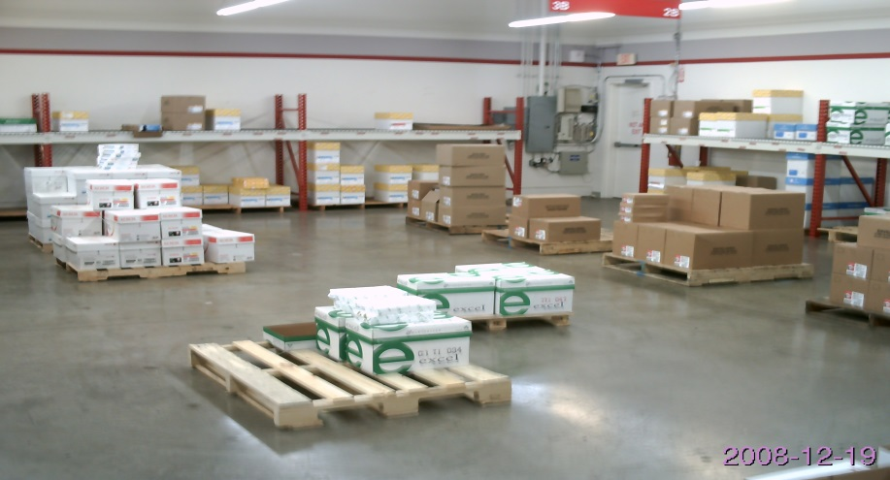
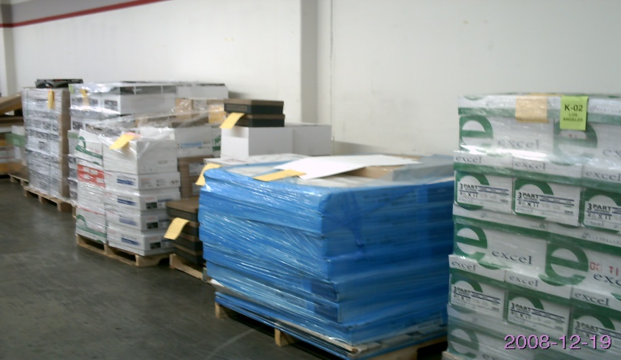
Counting Procedures
Count perimeter in to aisles:
  Once perimeter is counted, walk entire perimeter making sure everything that is not a primary bin location has a gold inventory count tag attached.
  Once all aisles are counted, walk entire perimeter and aisles making sure all product has a gold inventory count tag or inventory sticker/tag.
Notes:
Count perimeter into aisles:
Once perimeter is counted, walk entire perimeter making sure everything that is not a primary bin location has a gold inventory count tag attached.
Once all aisles are counted, walk entire perimeter and aisles making sure all product has a gold inventory count tag or inventory sticker/tag.(Colored Post It)

Slide 33
Counting Procedures
No one is allowed to work over 12 hours without approval from the Regional Manager.
Make sure employees take their time and count accurately, not fast.
The goal is not speed or how fast you can get done, but accuracy, accuracy, accuracy.
Finally, all items are to be counted in the lowest unit of measure. Be sure inventory is counted in proper quantities for all items.
Notes:
No one is allowed to work over 12 hours without approval from the Regional Manager.
Make sure employees take their time and count accurately, not fast.
The goal is not speed or how fast you can get done, but accuracy, accuracy, accuracy.
Finally, all items are to be counted in the lowest unit of measure. Be sure inventory is counted in proper quantities for all items.

Slide 34
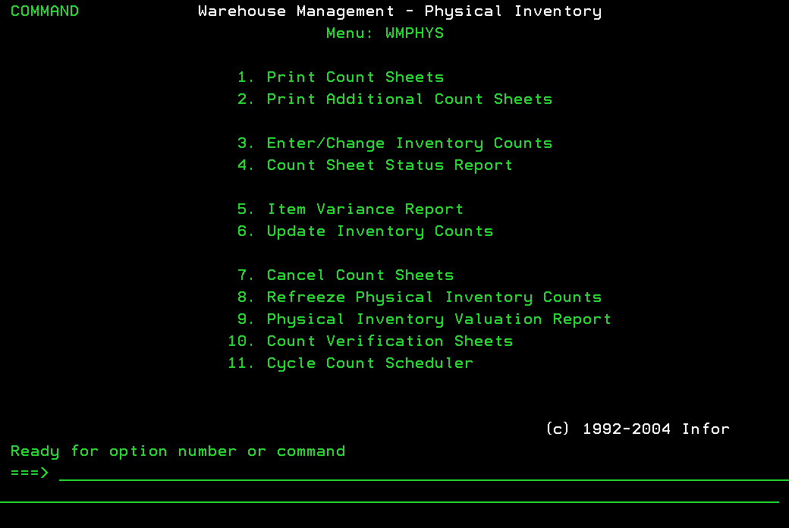
Entering Counts
Counts cannot be entered before 9:00am. No exceptions.
Take your time entering counts to minimize mistakes.
Do not enter 0 for products with no inventory.
To record no inventory for an item delete the item from the count.
See the EPAK topic Enter/Change Inventory Counts.
Notes:
Counts cannot be entered before 9:00am. No exceptions.
Take your time entering counts to minimize mistakes.
Do not enter 0 for products with no inventory.
To record no inventory for an item delete the item from the count.
See the EPAK topic Enter/Change Inventory Counts.

Slide 35
Entering Counts
After entering all counts you must run the Count Sheet Status Report.
The Count Sheet Status Report shows you the count sheets and/or locations not yet counted.
You can not update your physical inventory counts if you have not entered all sheets and locations.
Notes:
After entering all counts you must run the Count Sheet Status Report.
The Count Sheet Status Report shows you the count sheets and/or locations not yet counted.
You can not update your physical inventory counts if you have not entered all sheets and locations.

Slide 36
Item Variance Report
The item variance report shows variances between the counted value and book value of your inventory.
Control your variance reports just as you would control your count sheets.
Only hand out one variance report sheet per employee at a time.
Notes:
Item Variance Report
The item variance report shows variances between the counted value and book value of your inventory.
Control your variance reports just as you would control your count sheets.
Only hand out one variance report sheet per employee at a time.

Slide 37
Item Variance Report
1st Variance Report
The 1st variance will be run by bin location and you must recount ALL variances for accuracy.
The variance report will show you variance for that bin only, not the on hand.
Only count the bin on the report, unless there is a pink tag (if it has a pink tag you can go count where that pink tag was counted only)
  See the EPAK topic: Physical Inventory 1st Variance Report.
Notes:
1st Variance Report
The 1st variance will be run by bin location and you must recount ALL variances for accuracy.
The variance report will show you variance for that bin only, not the on hand.
Only count the bin on the report, unless there is a pink tag (if it has a pink tag only go count where that pink tag was counted)
See the EPAK topic: Physical Inventory 1st Variance Report for complete details on this topic.

Slide 38
Item Variance Report
2nd and All Subsequent Variance Reports
The 2nd and all other variances will be run by item number and you must look for high dollar variances and are to look everywhere in your location to find it.
You can also use A+ transaction history to determine where the problem might be at.
Remember you cannot count product you do not physically have.
  See the EPAK topic Physical Inventory 2nd Variance Report.
Notes:
2nd and All Subsequent Variance Reports
The 2nd and all other variances will be run by item number and you must look for high dollar variances and are to look everywhere in your location to find it.
You can also use A+ transaction history to determine where the problem might be at.
Remember you cannot count product you do not physically have.
See the EPAK topic: Physical Inventory 2nd Variance Report for complete details on this topic.

Slide 39
Changing Counts
Change your counts in A+.
  See the EPAK topic: Enter/Change Inventory Counts.
Notes:
Changing Counts
Enter any updated counts into A+.
See the EPAK topic: Enter/Change Inventory Counts.

Slide 40
Changing Counts
Anytime you go back in to a count sheet you must re-run the Count Sheet Status Report.
You can not update your physical inventory counts if you have not entered all sheets and locations.
Notes:
Anytime you go back in to a count sheet you must re-run the Count Sheet Status Report.
You can not update your physical inventory counts if you have not entered all sheets and locations.

Slide 41
Update Inventory Counts (Post)
Once you have finished double checking your variance and entering your changes and only after you have received approval from your District Manager you will Update your Inventory Counts (Post).
Notes:
Update Inventory Counts (Post)
Once you have finished double checking your variance and entering your changes and only after you have received approval from your District Manager you will Update your Inventory Counts (Post).

Slide 42
Update Inventory Counts (Post)
Before you update your inventory counts you must receive approval from your District Manager.
When performing this option the system will make sure the Count Sheet Status Report has been run and is blank.
If you have not done this the system will not post your inventory counts.
  See EPAK topic: Update Inventory Counts.
Notes:
Before you update your inventory counts you must receive approval from your District Manager.
When performing this option the system will make sure the Count Sheet Status Report has been run and is blank.
If you have not done this the system will not post your inventory counts.
See EPAK topic: Update Inventory Counts.

Slide 43
Count Sheets and Inventory Paperwork
Keep all count sheets from this inventory until next inventory.
Any hand written entries on your count sheets must be researched.
  The override locations may need to be fixed
  You may need to move the inventory in the system.
Notes:
Count Sheets and Inventory Paperwork
Keep all count sheets from this inventory until next inventory.
Any hand written entries on your count sheets must be researched.
The override locations may need to be fixed
You may need to move the inventory in the system.

Slide 44
Questions ?
David Mount @ 225

Slide 45
Physical Inventory Training

