Slide 1
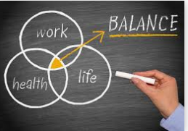
Your Wellness Matters
Especially in times of Crisis!

Slide 2

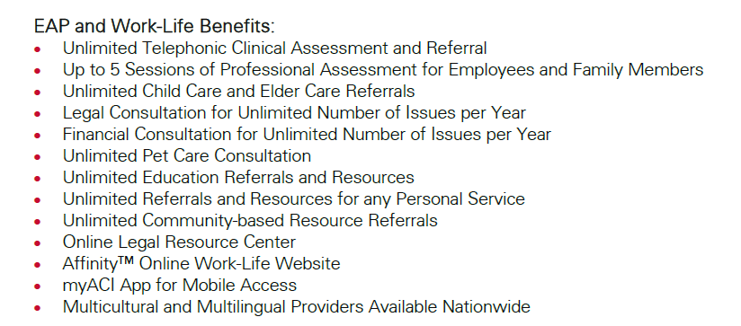
EAP: EMPLOYEE ASSISTANCE PROGRAM
Personal and confidential
1-855-775-4357
http://rsli.acieap.com

Slide 3

Easy & Free Ways to
Navigate Stress
Free YouTube Meditation & Yoga Sessions
Remember to drink plenty of water throughout the work day
Prepare healthy meals and snacks for your work day
Stay informed of government and local updates, but limit media as you feel necessary (news, social media, etc.)
When you are not working, give yourself the time to do something restorative: consider coloring books, online meditation/Yoga or simply rest!
Have fun with your new workspace! Personalize it as you would at work.
Get a good night’s sleep
Reach out and stay connected – even if it’s virtually or by phone

Slide 4

Got Kids at Home?
Communicate expectations for the workday (at age level)
Plan for children to watch favorite, yet educational shows (PBS has a lot of great options)
Educational games and apps
Reading/writing/journaling
Minecraft, or any other online game where your child can socialize virtually
Reward good behavior
Take breaks/lunches and spend them with your kiddos!

